Slide 1



Consumer Goods
Ad-Hoc insights
CREATED BY-
SANYUKTA CHETIA

Slide 2

Company Overview
Atliq Hardwares is one of the leading computer hardware and accessory manufacturer in India and well expanded in other countries too.

Slide 3


Challenges
The management noticed that they do not get enough insights to make quick and smart data-informed decisions.
They want to expand their data analytics team by adding several junior data analysts.
Tony Sharma, their data analytics director wanted to hire someone who is good at both tech and soft skills.
Hence, he decided to conduct a SQL challenge which will help him understand both the skills.
The Company seeks insights for 10 ad-hoc requests.

Slide 4
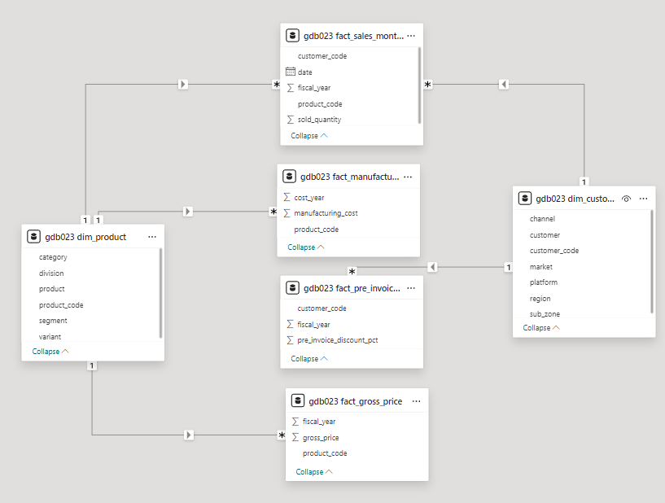
DATA MODEL

Slide 5
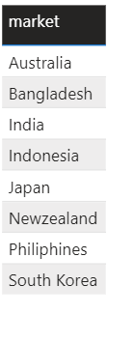
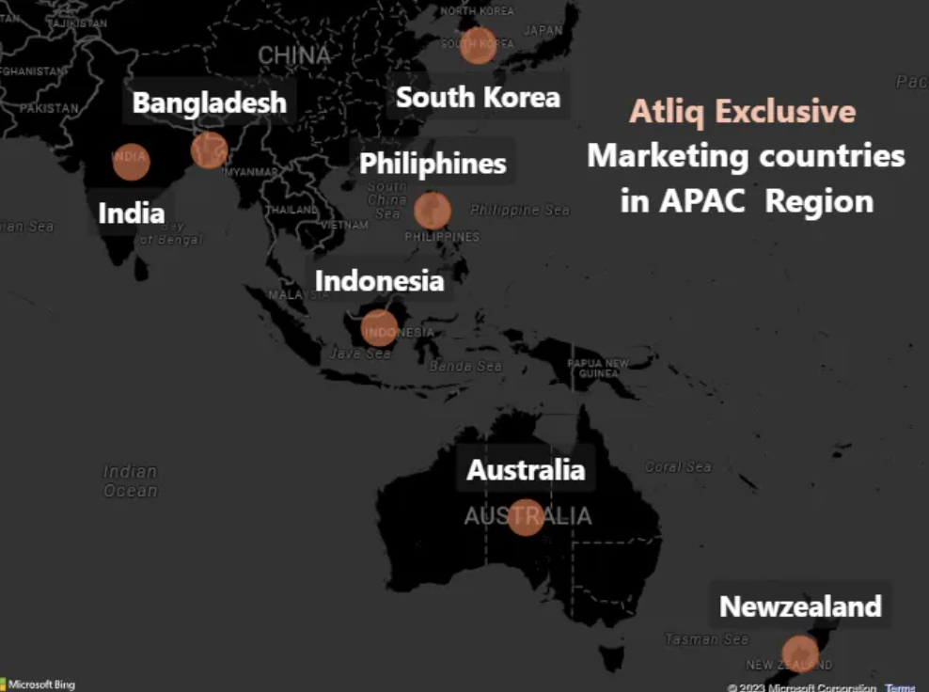

Request1:
Provide the list of markets in which customer "Atliq Exclusive" operates its business in the APAC region.
Output:

Slide 6
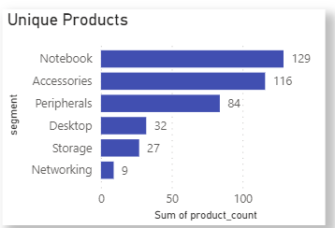
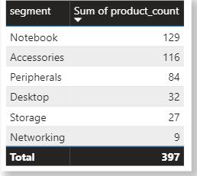

Request2:
What is the percentage of unique product increase in 2021 vs. 2020? The final output contains these fields, unique_products_2020 unique_products_2021 percentage_chg.
Output:
01
03
INSIGHTS:
Segments notebook, accessories and peripherals are showing significant manufacturing growth as compared to desktop, storage and networking.
Notebook, accessories and peripherals constitute 83% of total manufactured products.

Slide 7


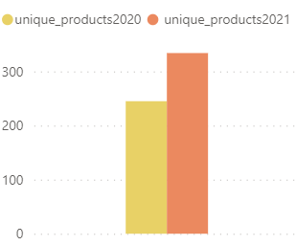
Request3:
Provide a report with all the unique product counts for each segment and sort them in descending order of product counts. The final output contains 2 fields, segment product_count.
Output:
01
03
36.33 %
INSIGHTS:
Demand and growth increased

Slide 8
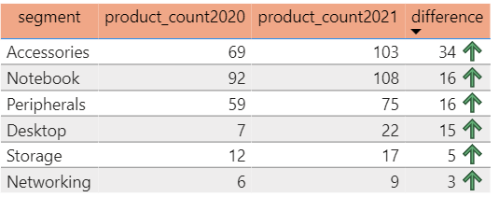
Request 4:
Follow-up: Which segment had the most increase in unique products in 2021 vs 2020? The final output contains these fields,
segment
product_count_2020
product_count_2021
difference.
Output:
INSIGHTS:
Accessories show the maximum increase in production.
Storage and networking segments show slow production growth

Slide 9

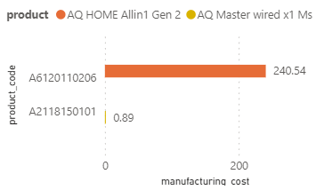
Request 5:
Get the products that have the highest and lowest manufacturing costs. The final output should contain these fields,
product_code
product
manufacturing_cost
Output:
INSIGHTS:
AQ HOME Allin1 Gen 2 laptop has the highest manufacturing cost of 240.54 $.
AQ Master wired x1 Ms peripheral mouse has the lowest manufacturing cost of 0.89 $.

Slide 10
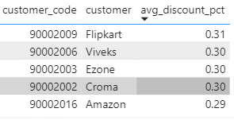
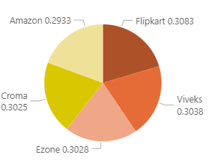
Request 6:
Generate a report which contains the top 5 customers who received an average high pre_invoice_discount_pct for the fiscal year 2021 and in the Indian market. The final output contains these fields,
customer_code
customer
average_discount_percentage
Output:
INSIGHTS:
The largest average pre-invoice-discount was given to Flipkart.
The least average pre-invoice-discount was given to Amazon.

Slide 11
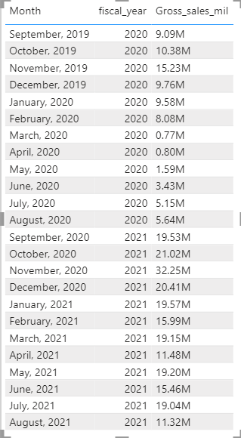
Request 7:
Get the complete report of the Gross sales amount for the customer “Atliq Exclusive” for each month . This analysis helps to get an idea of low and high-performing months and take strategic decisions. The final report contains these columns:
Month
Year
Gross sales Amount
Output:
INSIGHTS:
The lowest gross sales for both fiscal years is in March 2020.
The highest gross sales for both fiscal years is in November 2020.
73.8% of total gross sales is in the FY 2021.

Slide 12
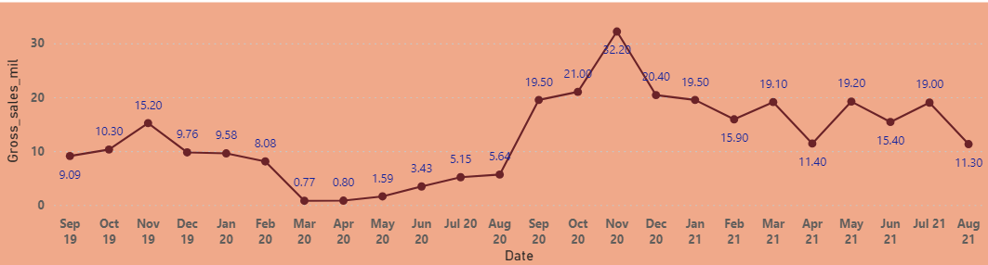

FY 2020
FY 2021
REASON:
Most probably due to COVID-19.

Slide 13
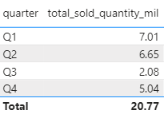
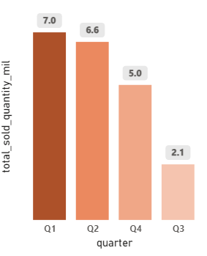
Request 8:
In which quarter of 2020, got the maximum total_sold_quantity? The final output contains these fields sorted by the total_sold_quantity,
Quarter
total_sold_quantity
Output:
INSIGHTS:
Quarter 1 had the most units sold in FY2020, whereas Quarter 2 had the fewest.
The decline of sales may be due to COVID-19 pandemic, which peaked around March 2020.

Slide 14
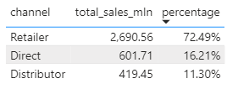
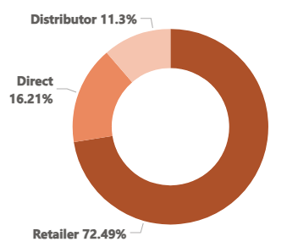
Request 9:
Which channel helped to bring more gross sales in the fiscal year 2021 and the percentage of contribution? The final output contains these fields,
Channel
gross_sales_mln
percentage
Output:
INSIGHTS:
Channel “Retailer” helped bring the most sales to the company with 72.5% contribution.
Channel “Distributor” made the least contribution in sales with 11.3% contribution.

Slide 15
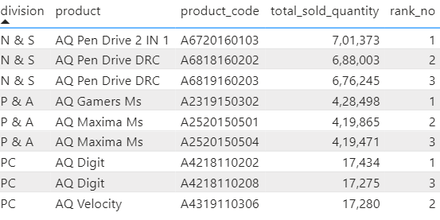
Request 10:
Get the Top 3 products in each division that have a high total_sold_quantity in the fiscal_year 2021? The final output contains these fields,
Division
product_code
Product
total_sold_quantity
rank_order
Output:

Slide 16
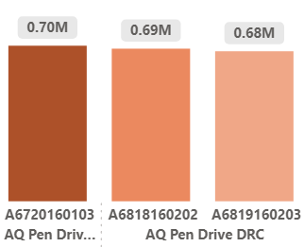
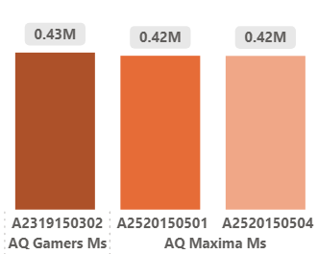
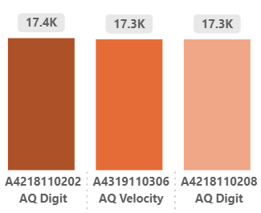
N & S
P & A
PC

Slide 17
THANKYOU!

